Slide 1
Technical Fundamentals
Chapter 2

Slide 2
Sources of Network-Based Evidence
On the wire
In the air
Switches
Routers
DHCP servers
Name servers
Authentication servers
Network Intrusion Detection/Prevention Systems
Firewalls
Web proxies
Application servers
Central log servers
Notes:
Forensic value of the above evidence sources:
On the wire: the capability to “tap” into the wire directly to gather data. Vampire taps, fiber taps, infrastructure taps.
In the air: wireless access points broadcast data, and is easily gathered by investigators. Even if data is encrypted, there is some information that can be gleaned from wireless APs.
Switches: contain a “content addressable memory” table, which stores mappings between physical ports and each network card’s MAC address. This can be used to trace back to a wall port and potentially a specific computer. See section 3.1.4.1 for more details.
Routers: routing tables allow us to view what networks a router knows about, and what route network traffic takes to get from one network to another. Traffic can be logged and sent to a central logging server, or kept locally, if space allows. This is a rich place to gather artifacts relating to network forensics. These devices are widely deployed and provide a lot of information.
DHCP servers: logs can show what specific network card was assigned an IP address, at a given time.
Name servers: these can log name queries for given IP addresses and hostnames. Timestamps are also tied to queries, which allows investigators the ability to build a timeline of user activity.
Authentication servers: log successful/failed login attempts. Investigators can review these logs to identify brute-force attacks, account logins at suspicious hours or unusual locations, or unexpected privileged logins, which might indicate questionable activities.
Network IDS/IPS: can be used to identify attacks in progress, anomalous behavior taking place on the network, and command-control traffic involving systems already compromised.
Firewalls: logging has become a big part of firewalls, and provides granular capabilities for gathering data.
Web proxies: gold mine if configured to keep logs for a long time. Stores web history for an entire organization, instead of a single user.
Application servers: types include – database, web, email, chat, and VoIP/voicemail servers. Select targets for evidence based on investigation taking place.
Central log servers: allows investigators to correlate data across multiple sources.

Slide 3
Principles of Internetworking
Protocols
Open Systems Interconnection Model (OSI)
Example: Around the world and back (see next slides)
Questions
Analysis
Notes:
Questions:
How did your web browser know how to speak Mandarin to some web server somewhere?
How did your web browser know where to find that faraway web server, in order to speak to it in the first place?
How did your laptop manage to send it a signal in such a way that the wireless access point sent the request along to the destination?
How was it that your laptop established itself on the Internet and could communicate with other systems?
What was the route that your laptop used to talk to that remote web server, and how did it figure that out?
How did the destination web server know what your request meant and how to format a reply so that your Mac would be able to interpret it (both with Hanzi and in English)?

Slide 4
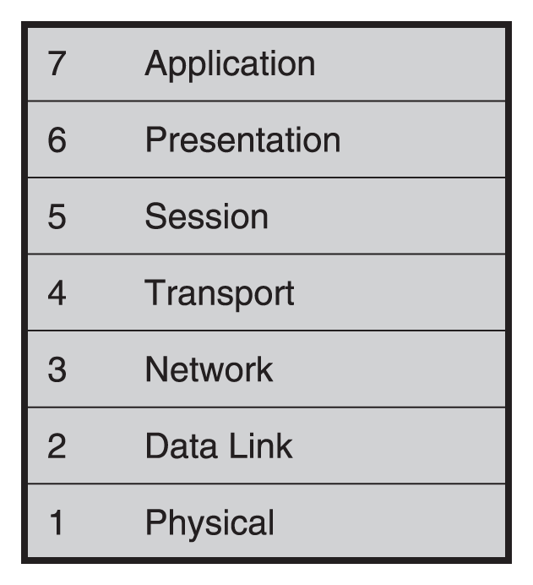
From Network Forensics, by Sherri Davidoff and Jonathan Ham (ISBN: 978-0-13-256471-7) Copyright © 2012 Pearson Education, Inc. All rights reserved.
Figure 2.1 Layers in the OSI model. Every network analyst should be fluent in the OSI model labels. Make sure you have memorized the numbers and descriptions of each of the layers so that you can converse about them easily.

Slide 5
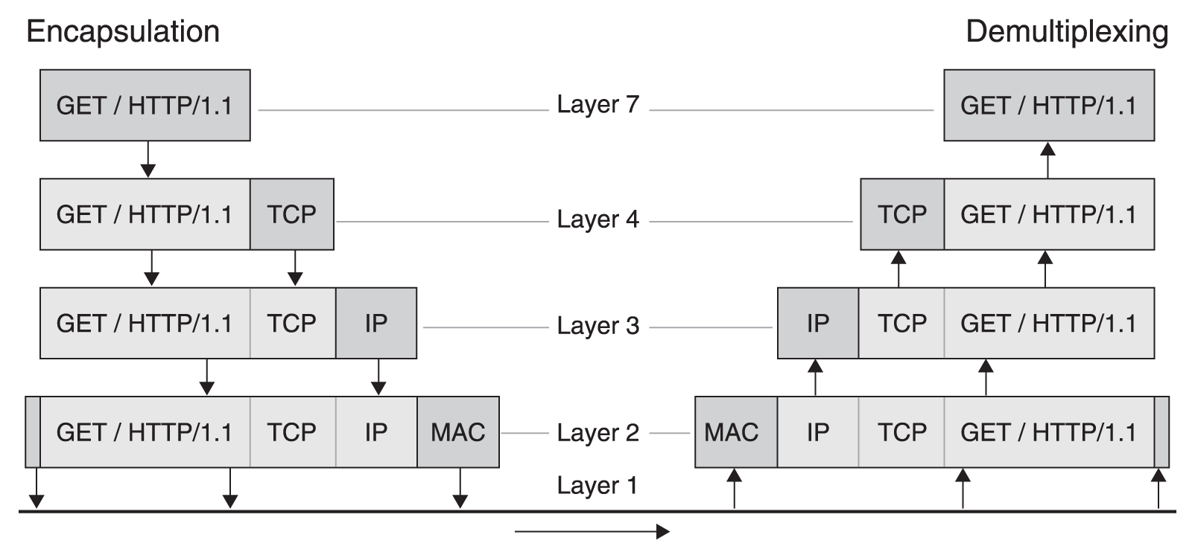
From Network Forensics, by Sherri Davidoff and Jonathan Ham (ISBN: 978-0-13-256471-7) Copyright © 2012 Pearson Education, Inc. All rights reserved.
Figure 2.2 An HTTP “GET” request, shown in the framework of the OSI model.

Slide 6
Internet Protocol Suite
Early history and development of the Internet Protocol Suite
Internet Protocol
Characteristics:
Support for addressing and routing
Connectionless
Unreliable
Includes a header (no footer)
Header plus payload is called an IP packet
IPv4 and IPv6 (examples on next slides)

Slide 7
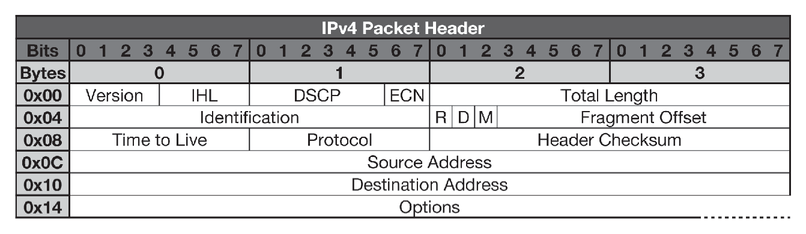
From Network Forensics, by Sherri Davidoff and Jonathan Ham (ISBN: 978-0-13-256471-7) Copyright © 2012 Pearson Education, Inc. All rights reserved.
Figure 2.3 The IPv4 packet header.

Slide 8
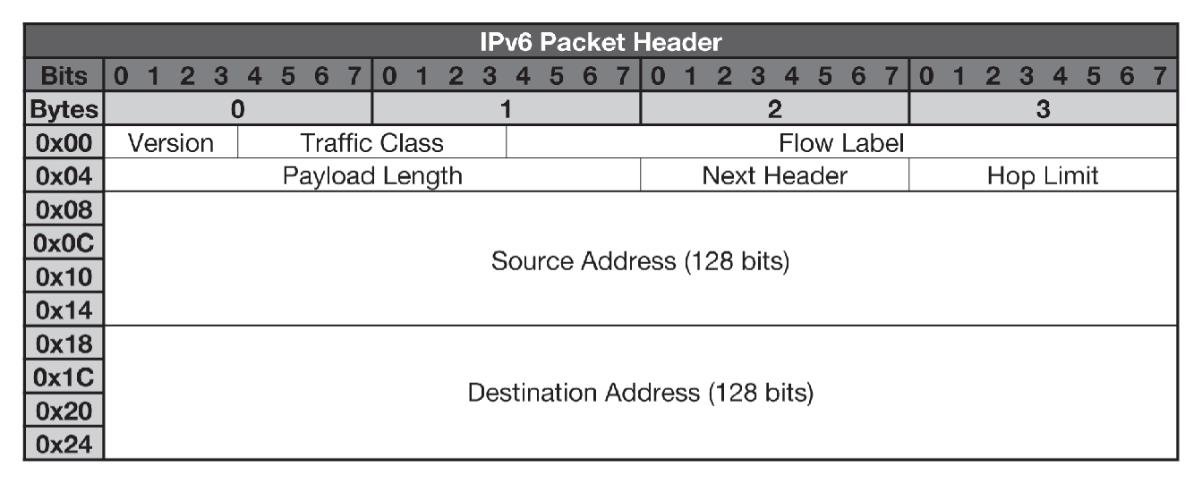
From Network Forensics, by Sherri Davidoff and Jonathan Ham (ISBN: 978-0-13-256471-7) Copyright © 2012 Pearson Education, Inc. All rights reserved.
Figure 2.4 The IPv6 packet header.

Slide 9
Internet Protocol Suite
Transmission Control Protocol (TCP)
Reliable
Connection-oriented
Handles sequencing
Port numbers range from 0 to 65535
Includes a header (no footer)
Header plus payload is called a TCP segment
User Datagram Protocol (UDP)
Unreliable
Connectionless
Port numbers range from 0 to 65535
Includes a header (no footer)
Header plus payload is called a UDP Datagram

Slide 10
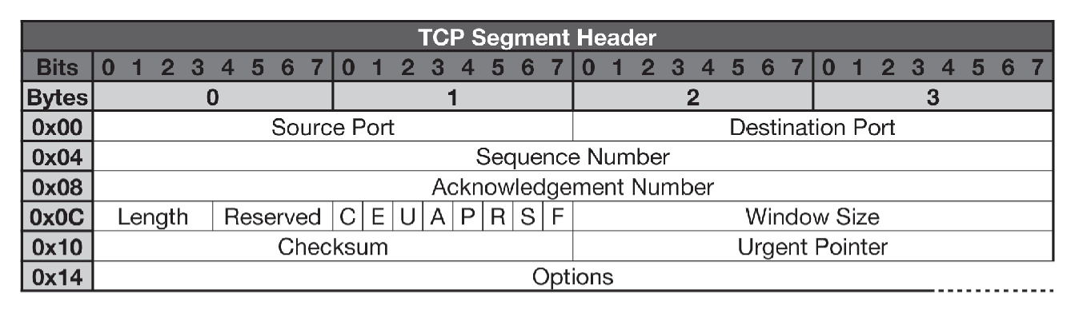
From Network Forensics, by Sherri Davidoff and Jonathan Ham (ISBN: 978-0-13-256471-7) Copyright © 2012 Pearson Education, Inc. All rights reserved.
Figure 2.5 TCP segment.

Slide 11
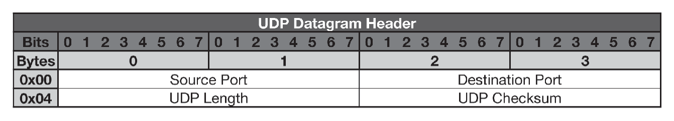
From Network Forensics, by Sherri Davidoff and Jonathan Ham (ISBN: 978-0-13-256471-7) Copyright © 2012 Pearson Education, Inc. All rights reserved.
Figure 2.6 UDP Datagram.

